Slide 1

CM3070 Pitch
Physics-based game
Notes:
For my final project I will be using the Physics-based game template

Slide 2
Boardgames
Notes:
My proposed game design will be based on simulating a tabletop board game.

Slide 3
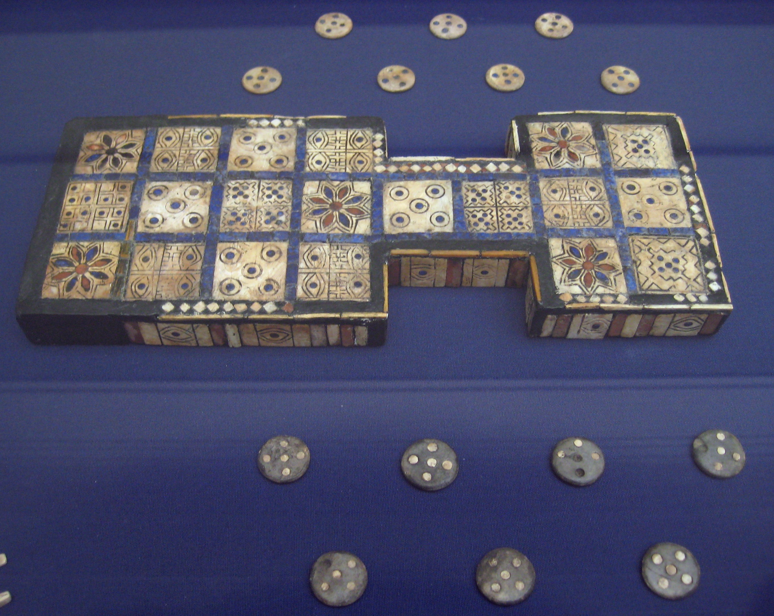
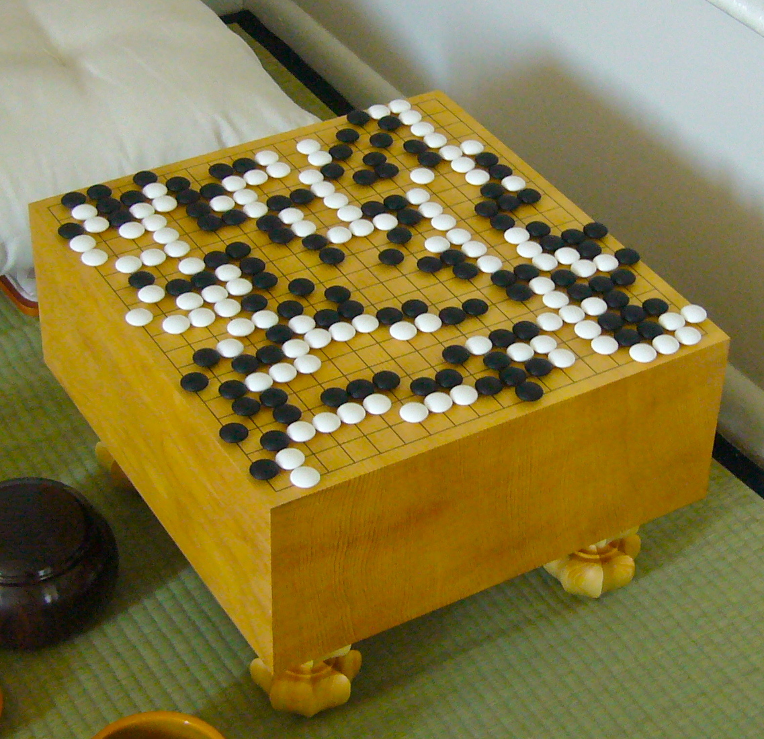
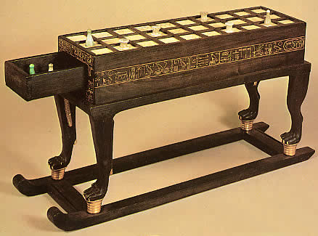
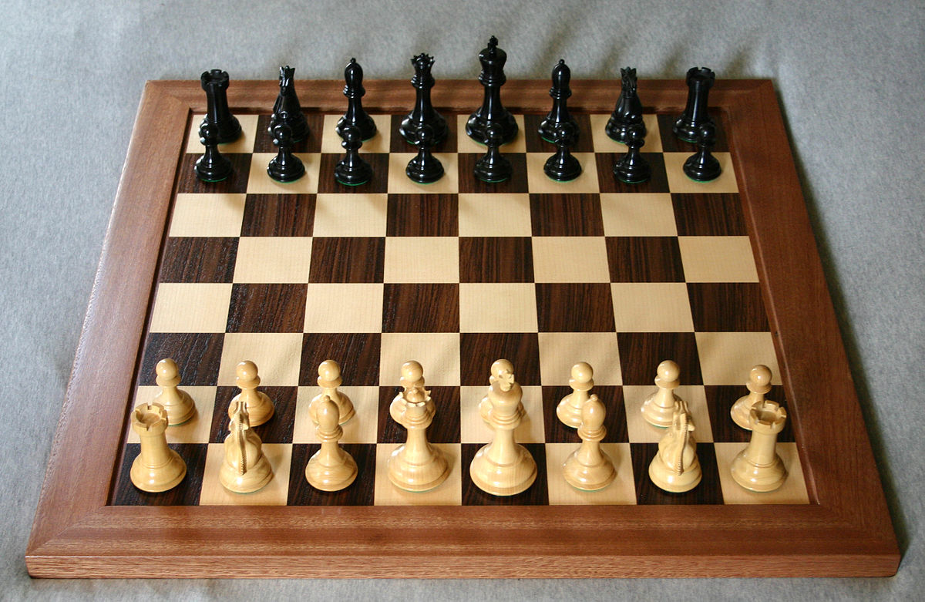
Boardgames
Royal Game of Ur: c.2600 BCE, Mesopotamia
Go: c.4000 BCE, China
Senet: c.2600 BCE, Egypt
Chess: c.1475 CE, Europe
Notes:
Humans have been playing boardgames for thousands of years and throughout the world. Archaeological examples exist from ancient cultures, and records show the evolution and propagation of games throughout history.

Slide 4
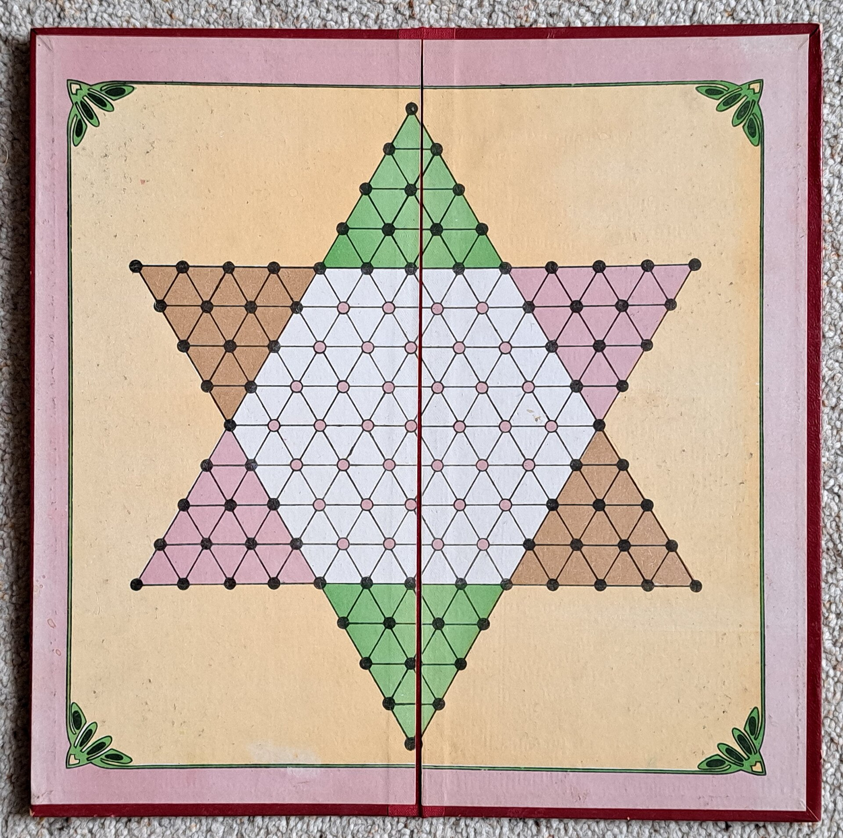
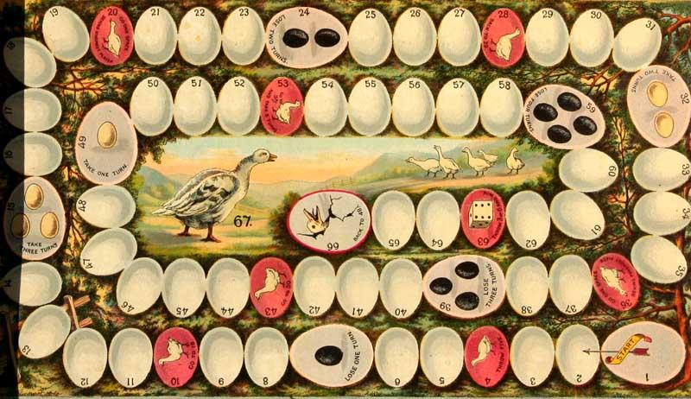
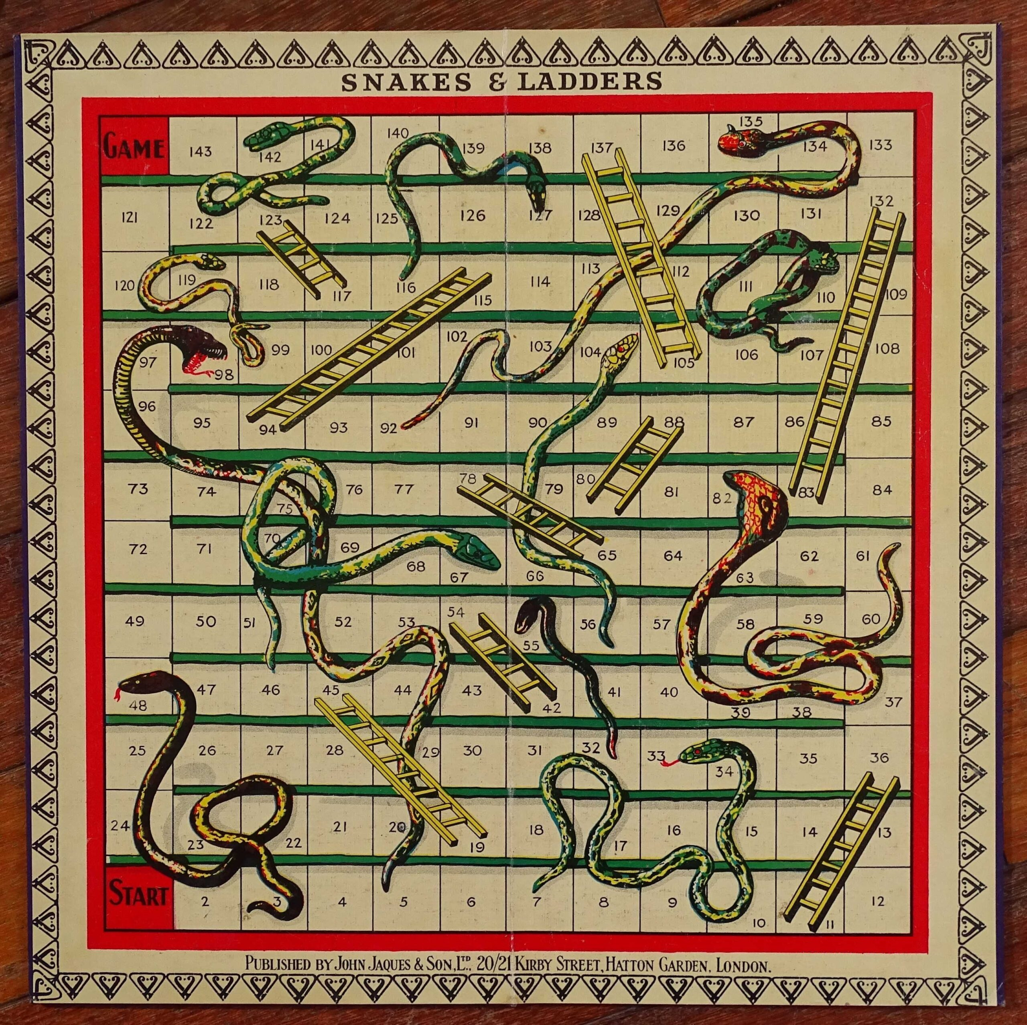
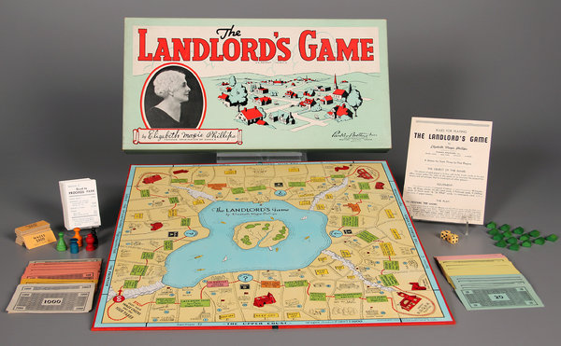
Boardgames
The Game of the Goose, c.1880
Halma (Chinese Checkers), 1883
Snakes & Ladders, 1890
The Landlord’s Game, 1904
Notes:
The late 19th and early 20th centuries are considered the first ‘Golden Age’ of board games. With the advent of commercial production, the variety and proliferation of these games dramatically increased.

Slide 5
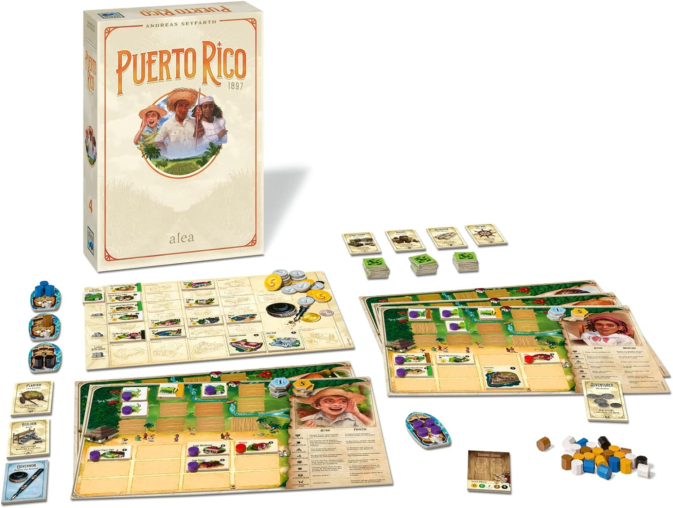
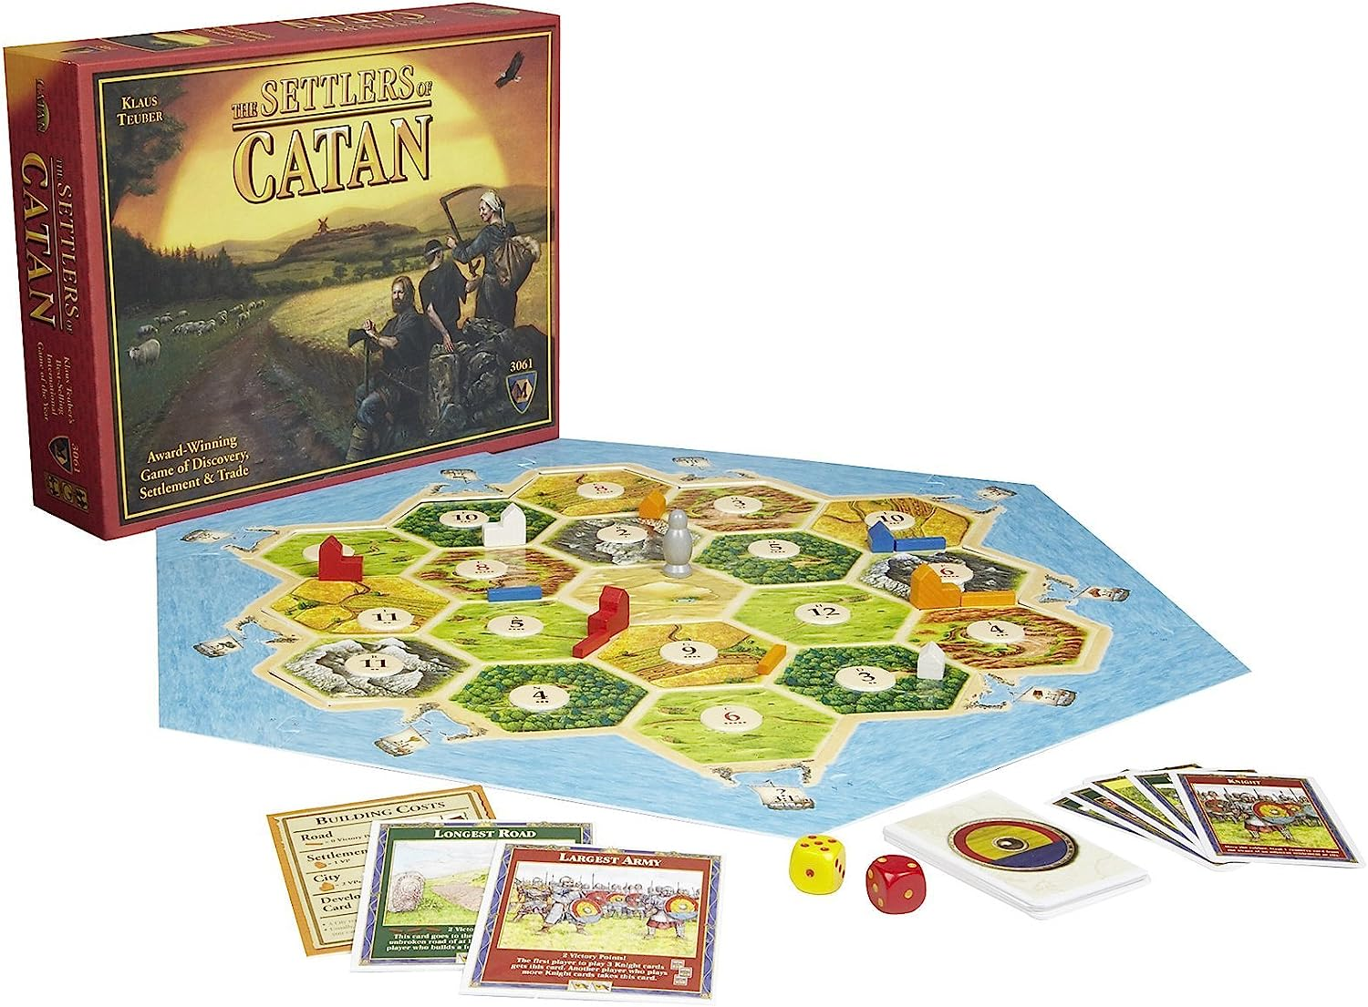
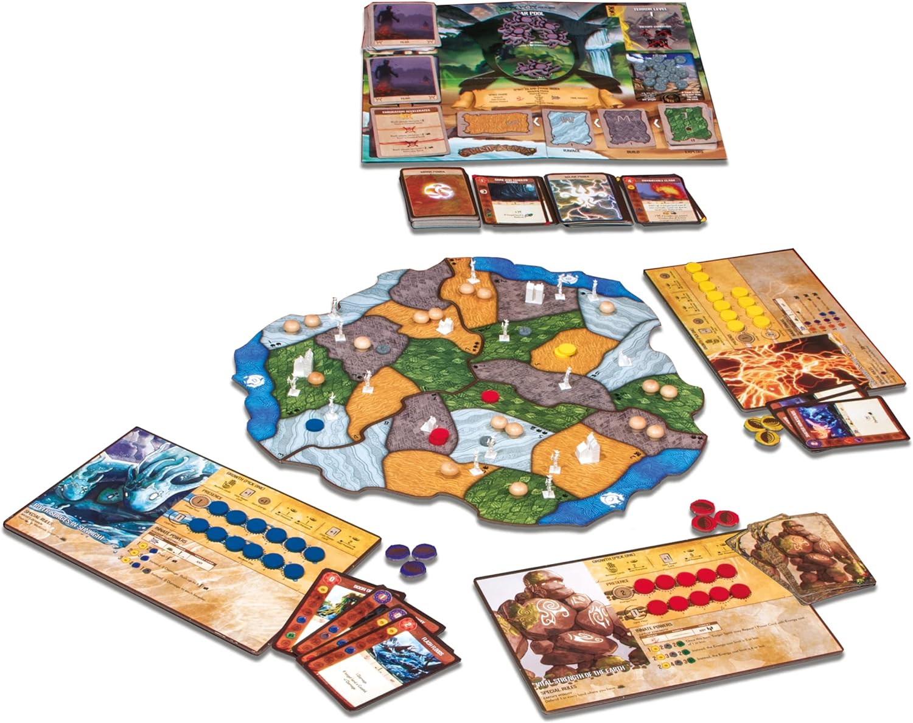
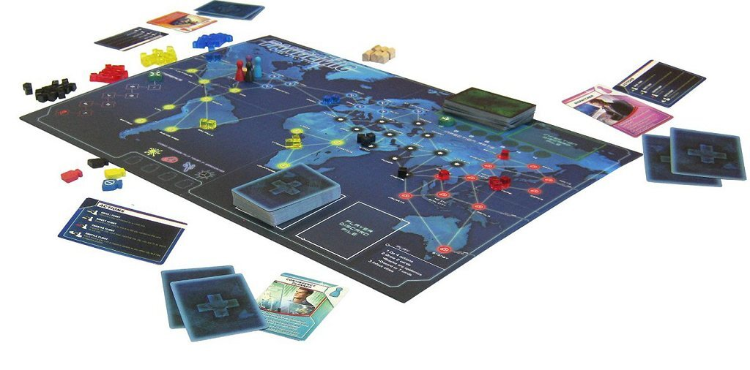
Boardgames
Puerto Rico, 2002
The Settlers of Catan, 1995
Spirit Island, 2017
Pandemic, 2008
Notes:
Since the 1990s the so-called “Board game renaissance” has seen a resurgence in the popularity and innovation of modern tabletop gaming.

Slide 6
Dexterity games
Notes:
While boardgames are inherently physical objects, a subset - known as “Dexterity games” - make explicit use of their physicality, and may thus be an appropriate influence for a physics-based computer game.

Slide 7
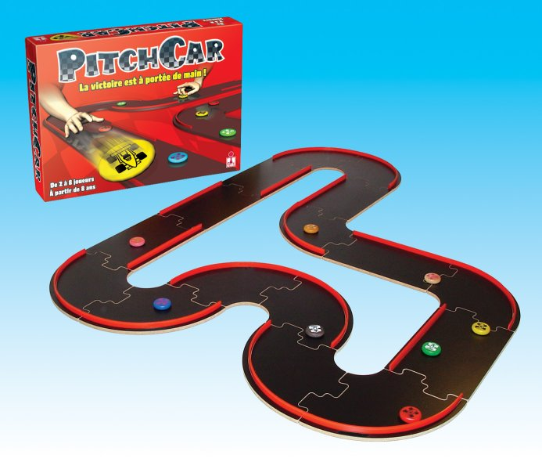
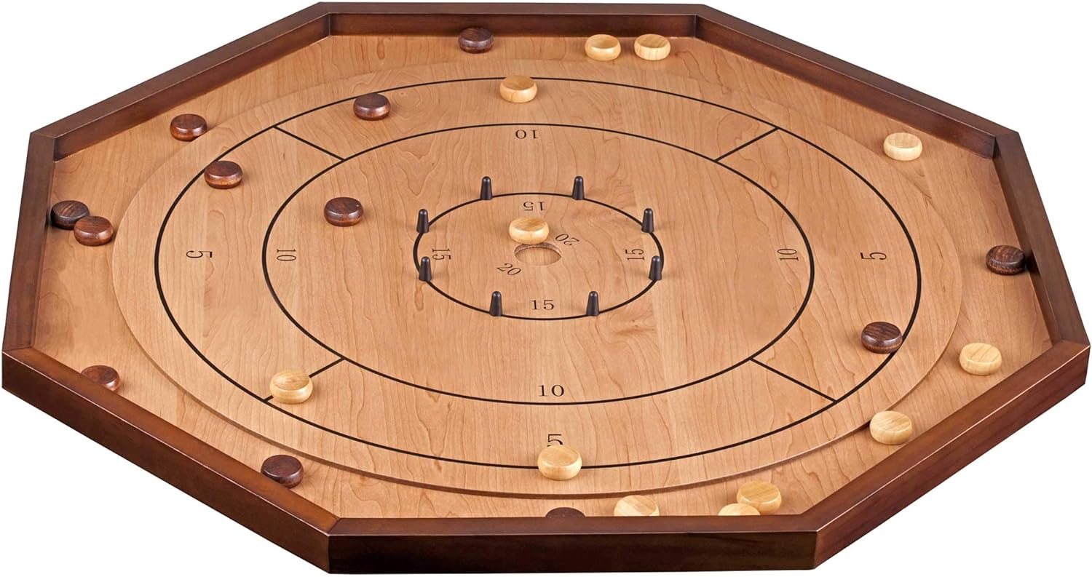
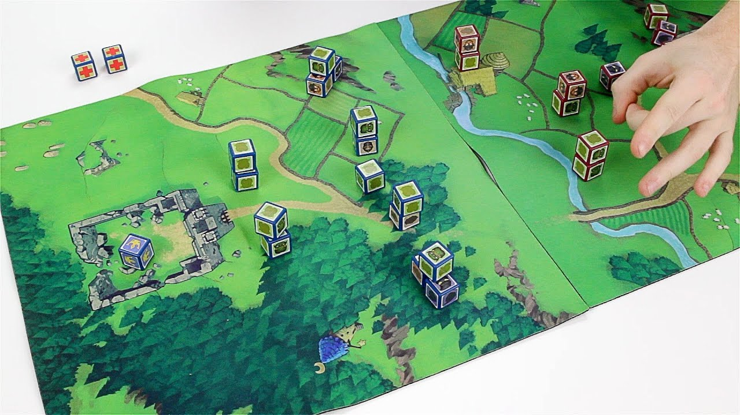
Dexterity games
Crokinole, 1876
PitchCar, 1995
Cube Quest, 2013
Notes:
These dexterity games can be divided into three types. Flicking games require the players to accurately maneuverer pieces around the game space, negotiating their interactions with other pieces or obstacles.

Slide 8
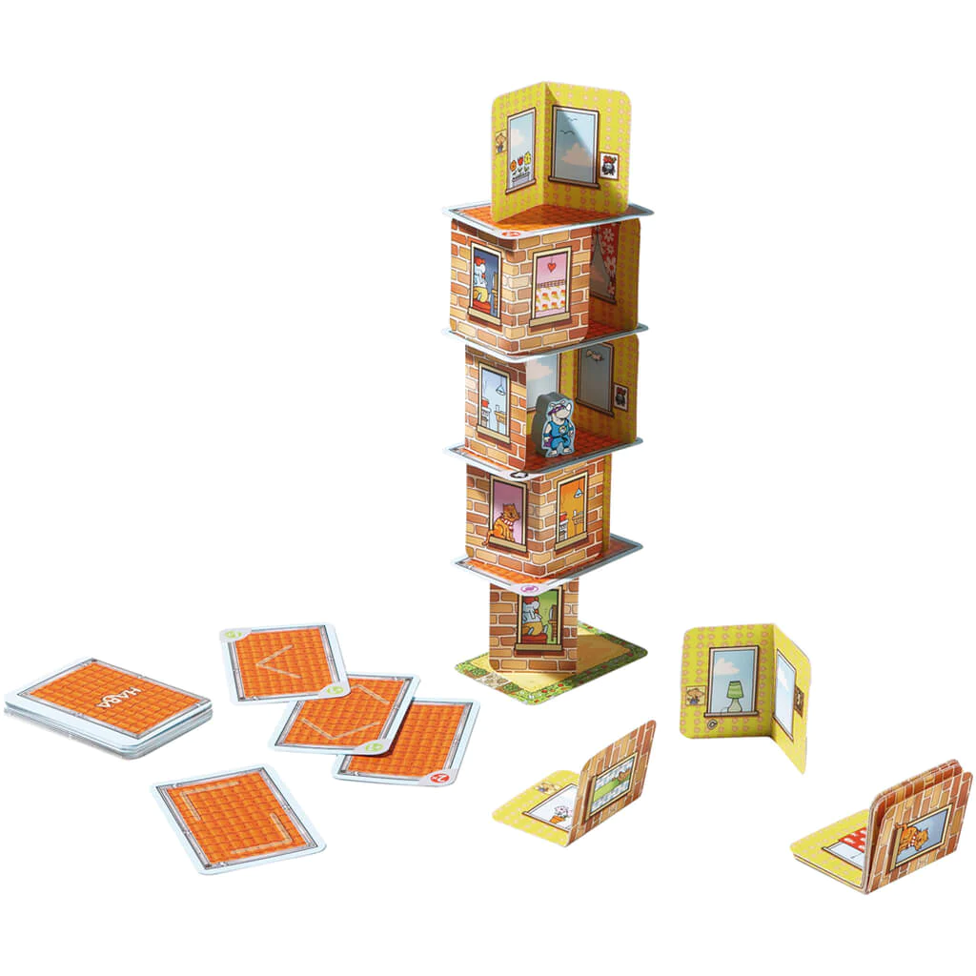
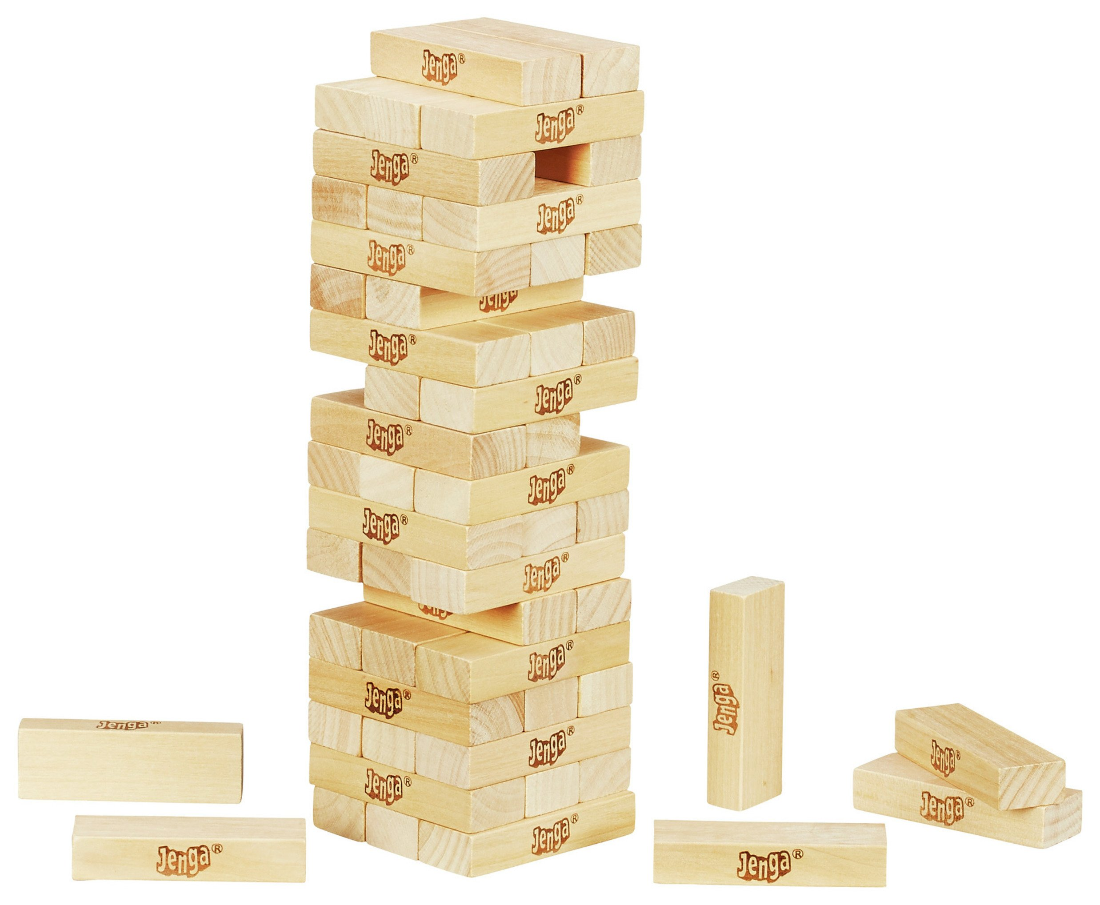
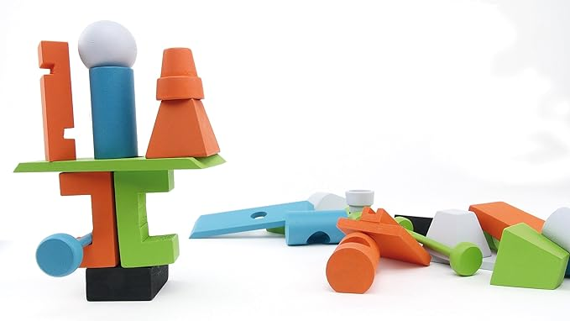
Dexterity games
Rhino Hero, 2011
Jenga, 1983
Junk Art, 2016
Notes:
Stacking games involve balancing pieces atop each other, generally with the goal of creating the tallest structure, or avoiding a collapse.

Slide 9
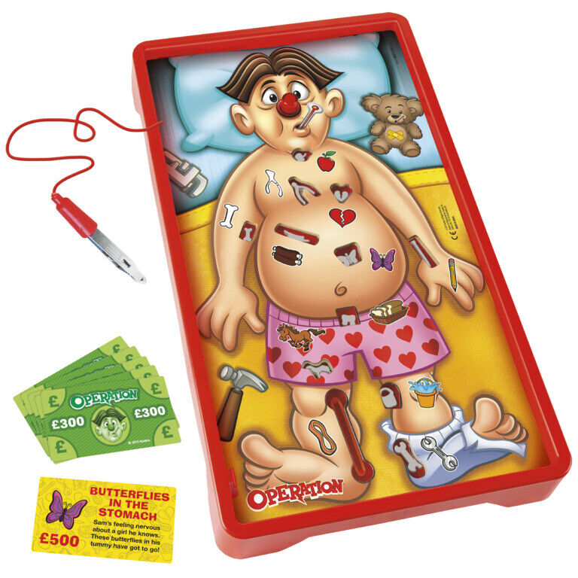
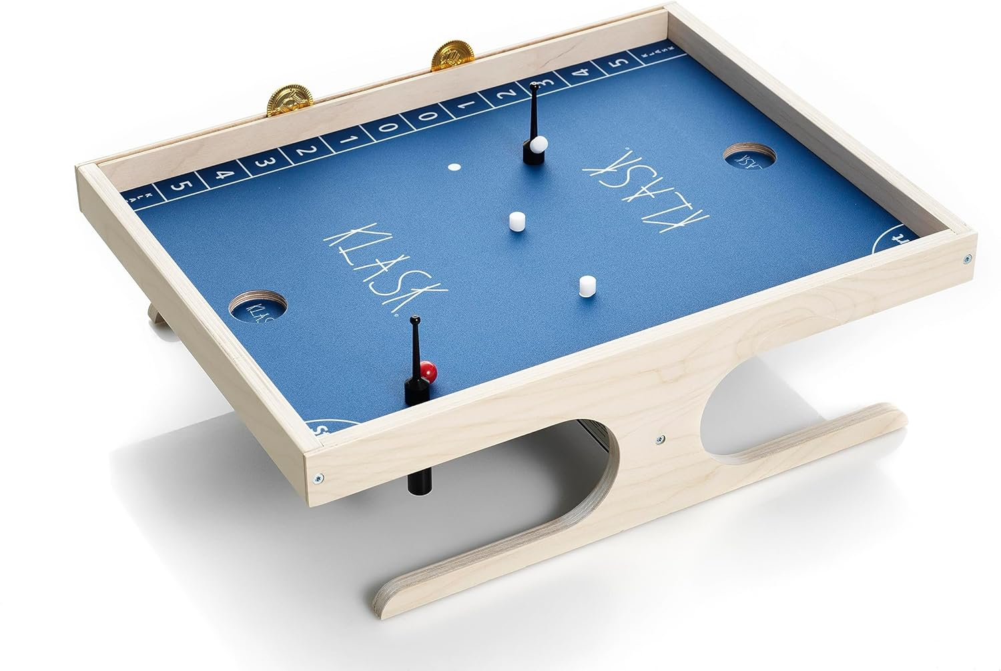
Dexterity games
Operation, 1965
Klask, 2014
Notes:
Fine control games rely on the players’ hand-eye coordination to perform various precise tasks.

Slide 10
Digital boardgames
Notes:
The resurgence of interest in board games in the last few decades has coincided with the expanding availability and capabilities of home computing devices and the internet. This has led to the development of several digital adaptations of these games.

Slide 11

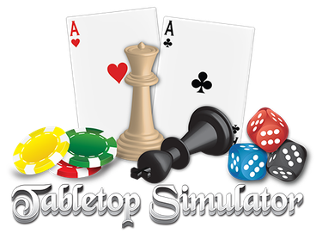
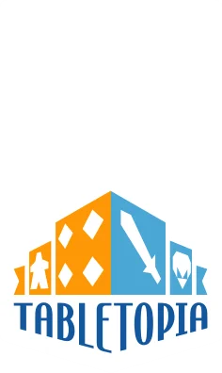
Digital boardgames
Notes:
Services such as Board Game Arena, Tabletopia, and Tabletop Simulator allow players to participate in a variety of games without requiring the physical space for their components, and with access to an internet’s worth of opponents (or team-mates).

Slide 12
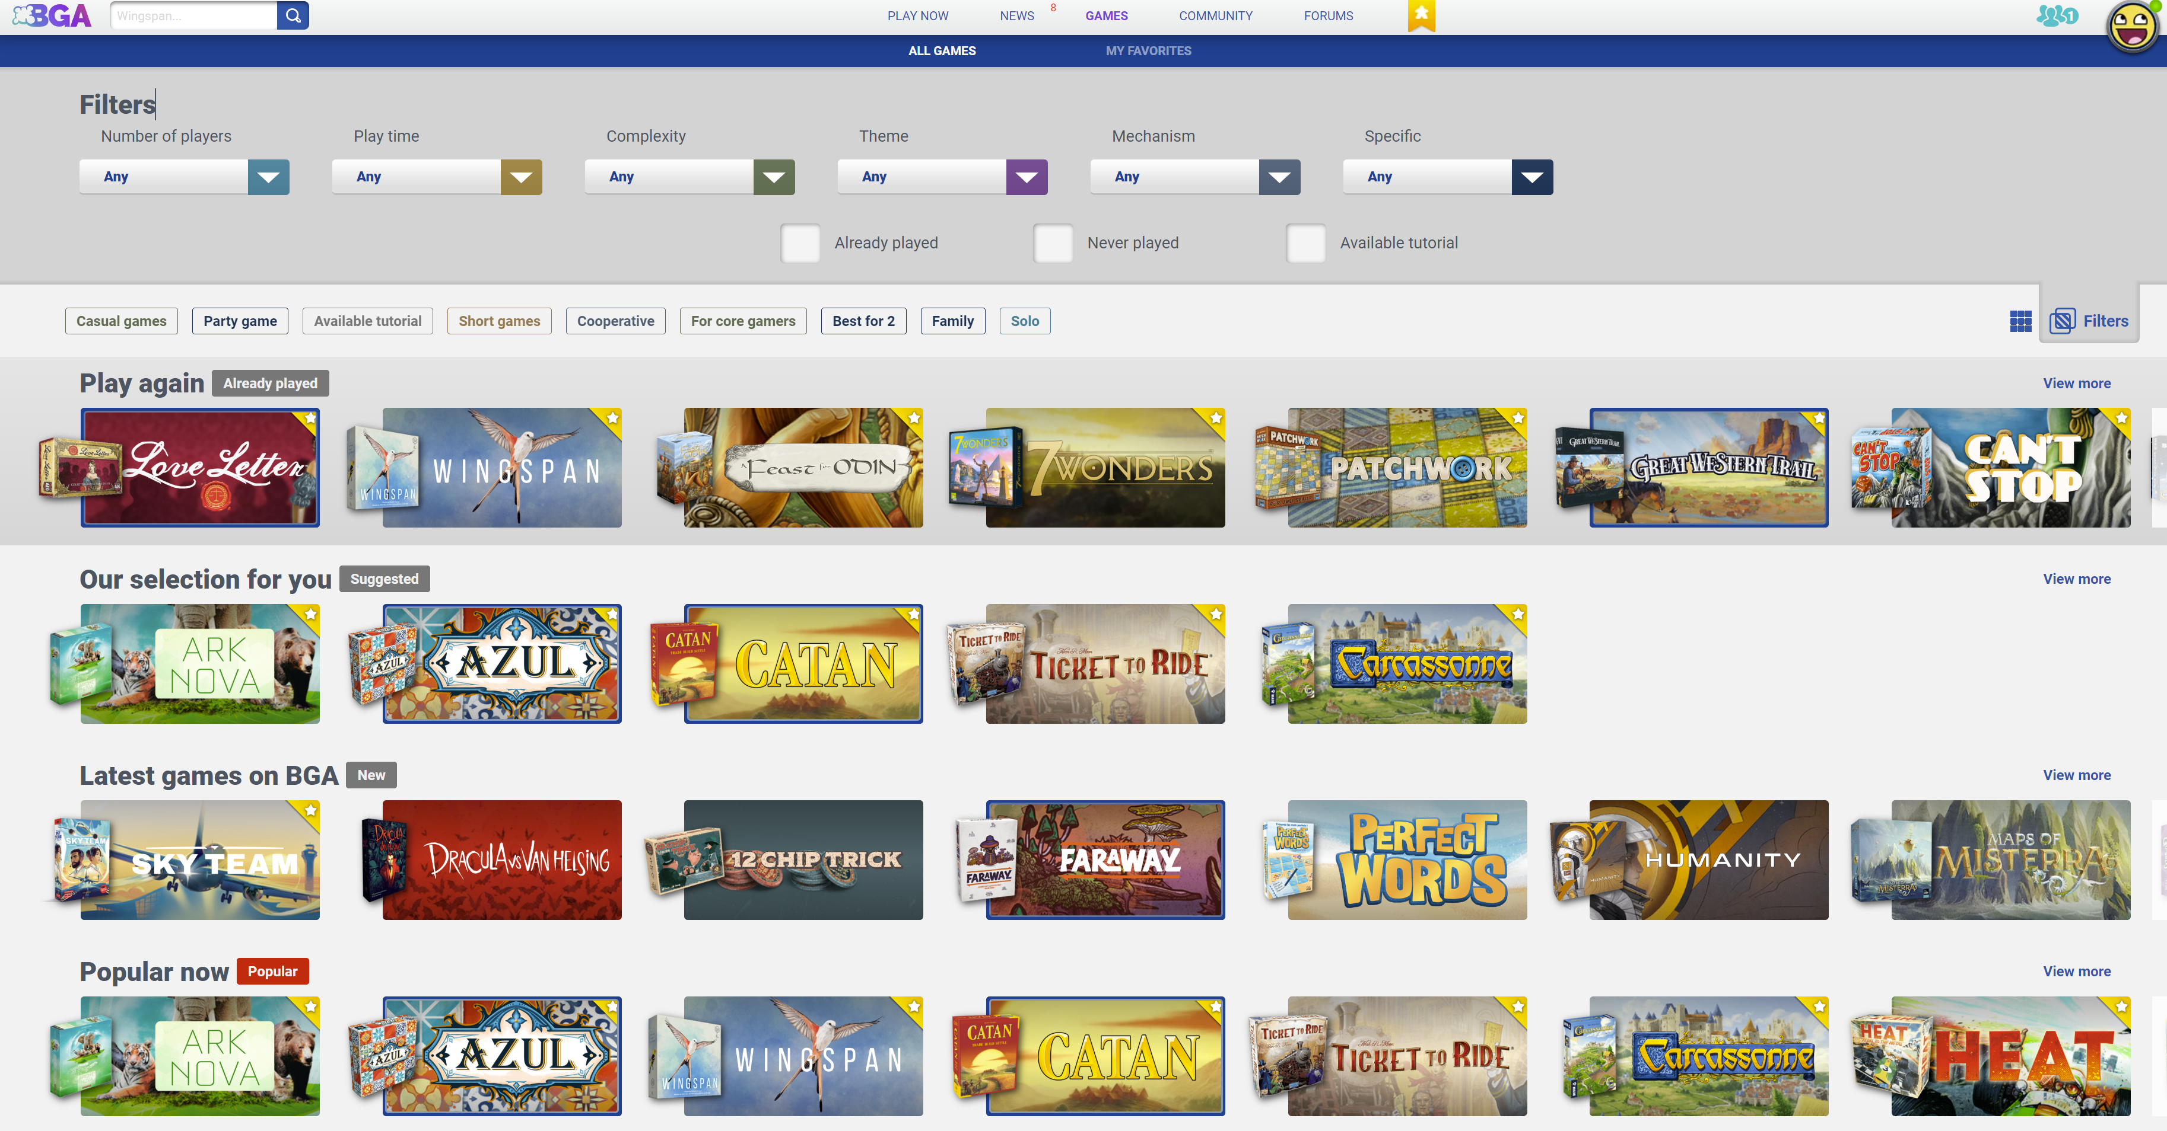
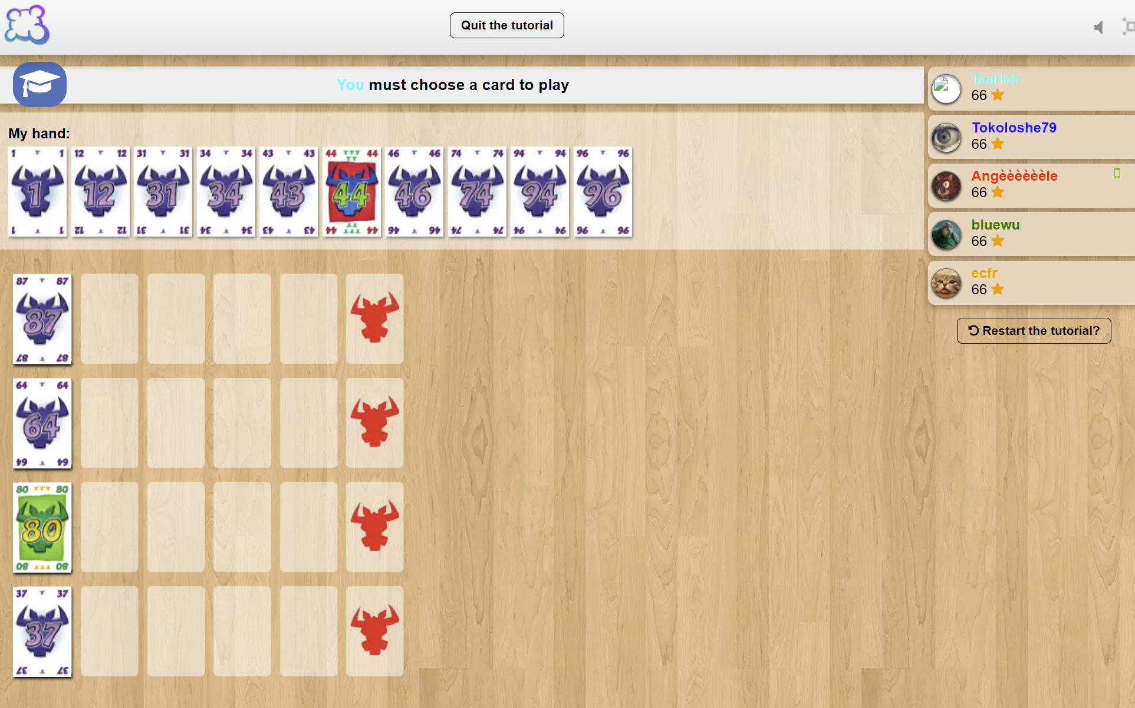
Digital boardgames
Notes:
Tabletopia and Board Game Arena are browser-based services, with subscription models. They host a curated list of licensed games, strongly enforcing their mechanics and rulesets. The game engines used are two-dimensional with no physics simulation, and are thus unsuitable platforms for hosting any type of physics-based dexterity game.

Slide 13
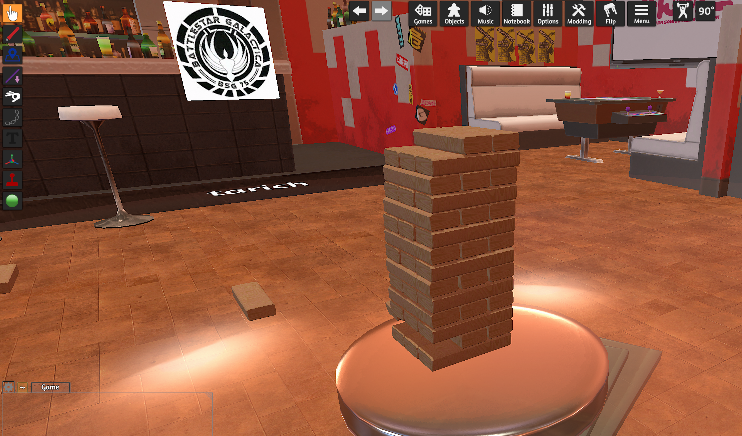
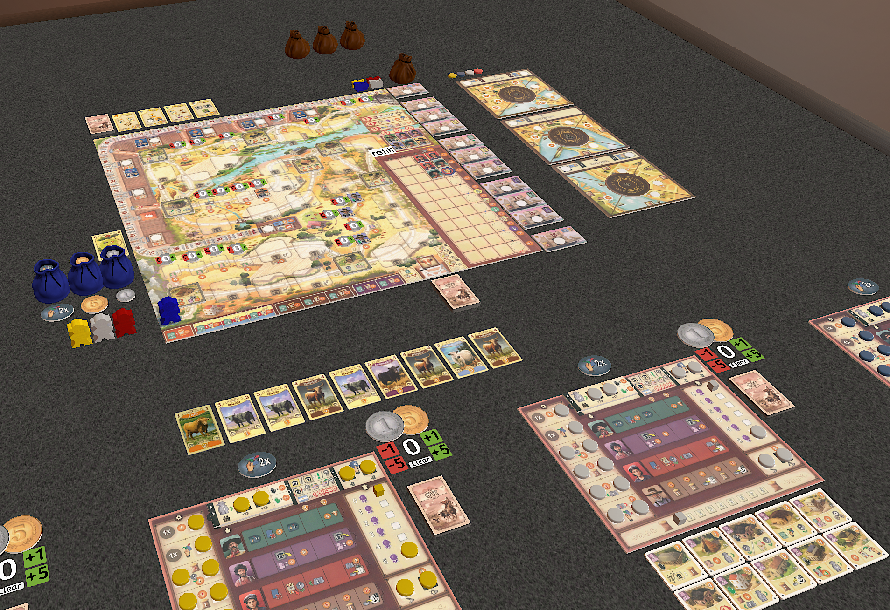
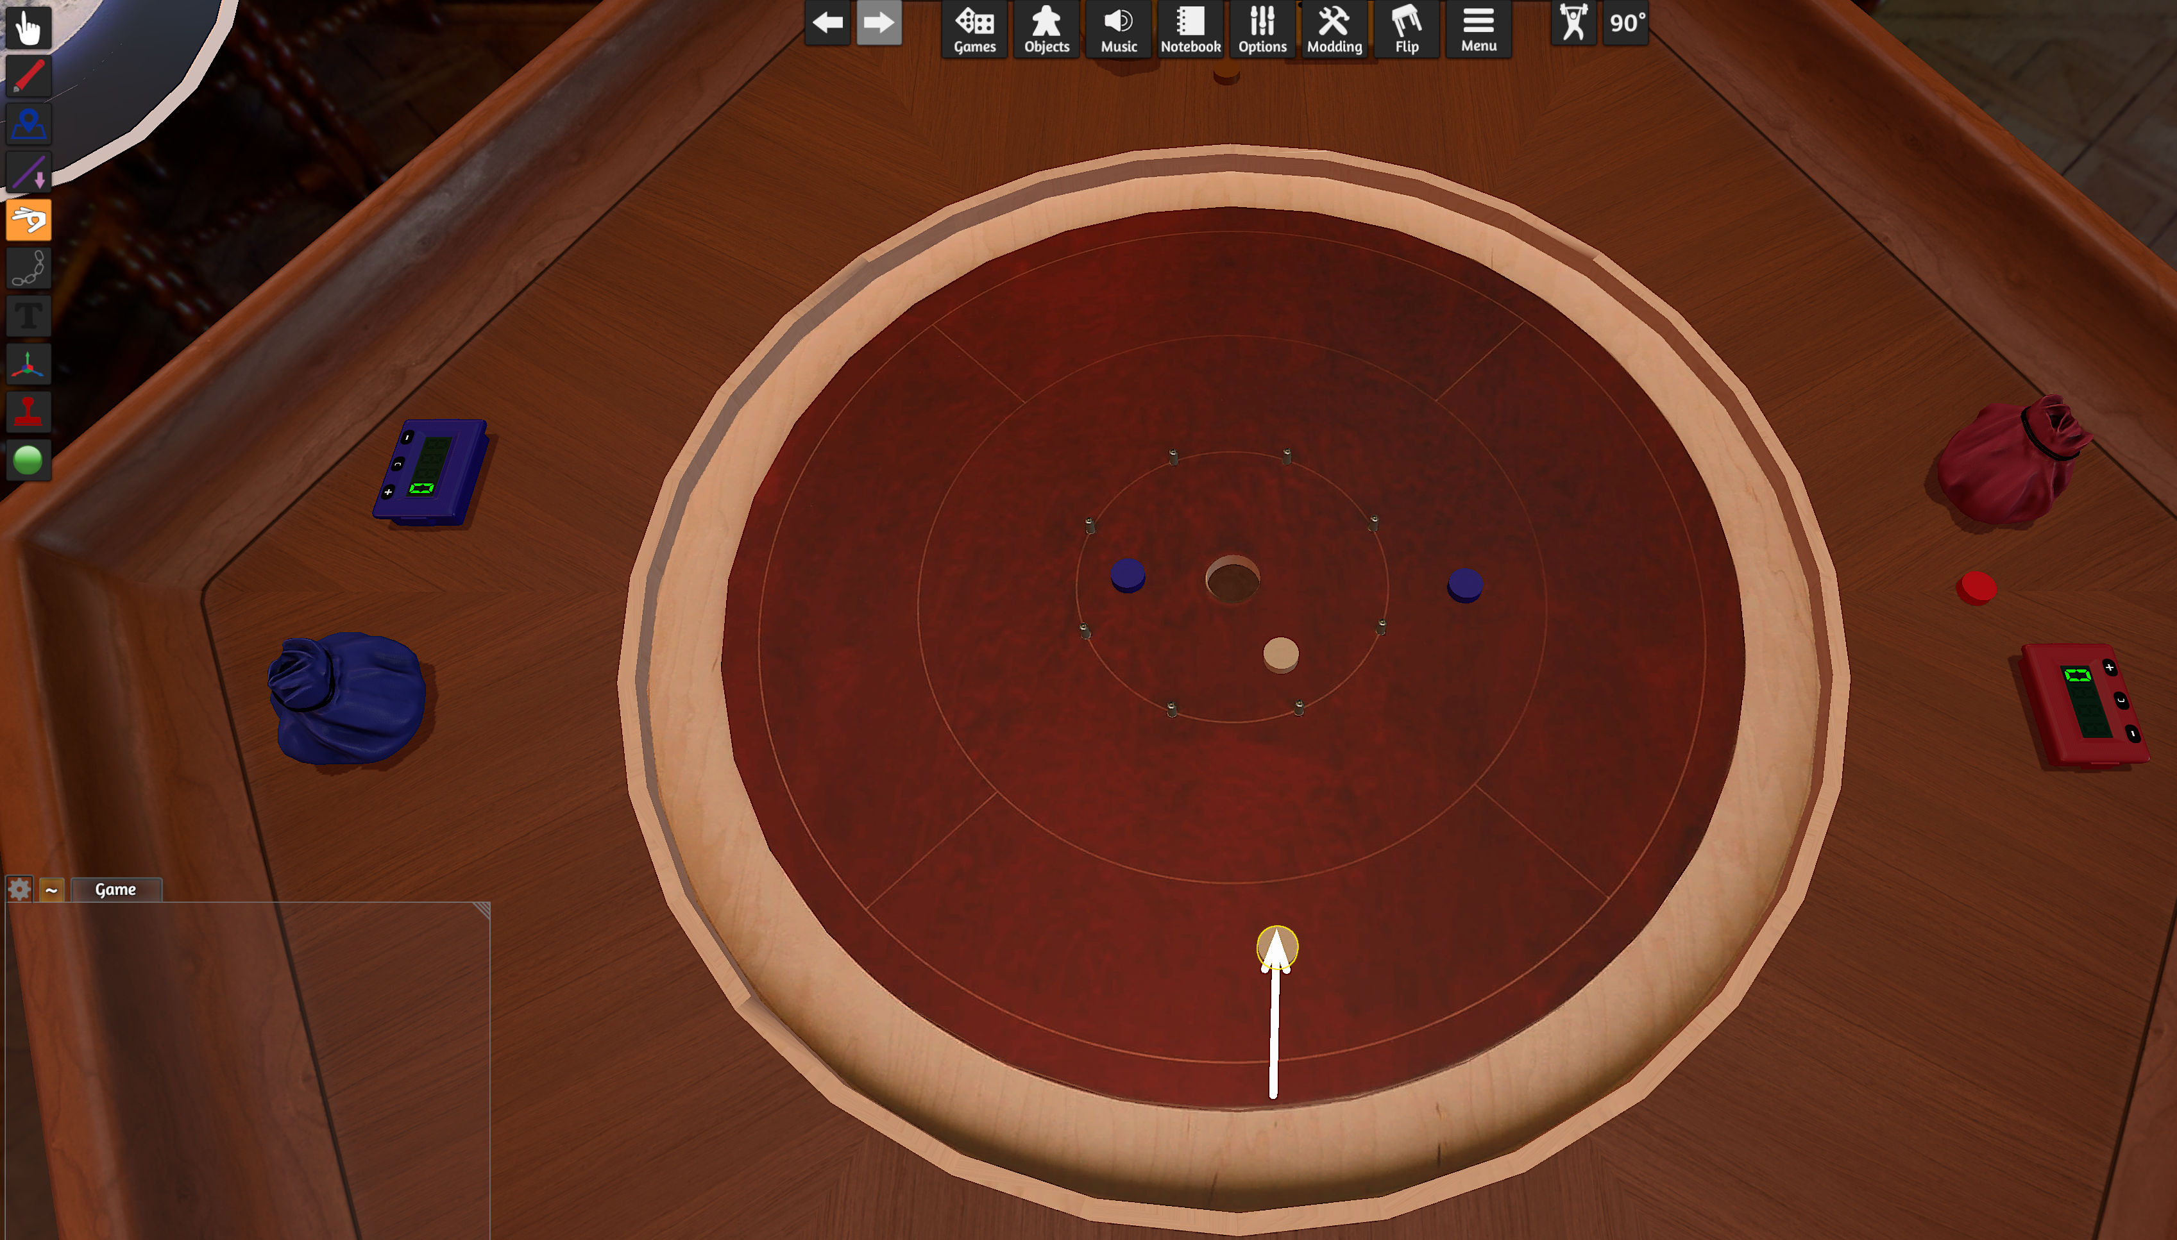
Digital boardgames
Notes:
Tabletop Simulator is a 3D ‘sandbox’ environment designed specifically to enable a realistic simulation of a board gaming experience. Game mechanics and rules are not enforced by the software, requiring players to move components around just as if playing on a real table. This allows great freedom in the types of games playable, but also requires the players to know - and manually implement - all game rules.
The intentionally generic nature of the gaming environment makes this software less suitable for some game types, especially dexterity games. The physics engine within the game is functional, but the control scheme can be unintuitive. The platform serves reasonably well at simulating flicking type games such as Crokinole, but even simple stacking games such as Jenga are fiddly, and in some cases virtually impossible to play convincingly.

Slide 14
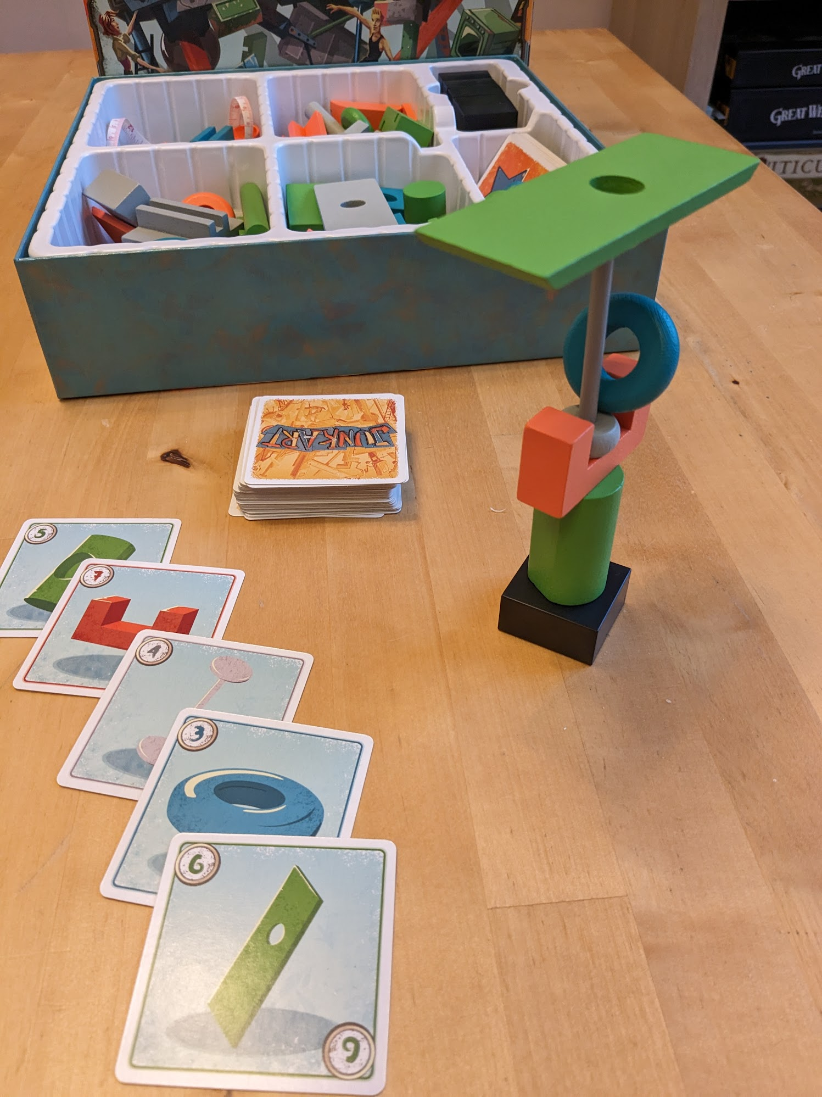
Junk Art
Physics simulation of stacking objects
Rules of game enforced
Automated scoring
‘Hotseat’ local multiplayer
Notes:
My proposal is to create a piece of software to simulate a single dexterity game, inspired by the physical game Junk Art - a game which revolves around the stacking of objects with unusual shapes. The software would include the physics of moving and stacking these objects, with an intuitive control scheme allowing players to move objects with six degrees of freedom. The rules and scoring of the game would be automatically managed by the software.
While online multiplayer will likely be out of scope for this project, local multiplayer via ‘hotseat’ or control-passing would be included.
Thank you for your time, and good luck to my fellow students with their own projects.

